Slide 1
Computer graphics sec6
DR. Heba ElHadidi
Eng. Naira Elmahlawy

Slide 2
Libraries
Graphics
Turtle
Open GL

Slide 3
Projection matrix functions
Function | Job
glMatrixMode(GL_PROJECTION) | Switch to the projection matrix
gluOrtho2D(coorX , coorY) | Determine the two-dimensional view.
gluPerspective(angle, width/height, near, far) | Determine the three-dimensional view.

Slide 4
Camera control functions and transformation
Function | Job
glMatrixMode(GL_MODELVIEW) | Define the model matrix and view.
glTranslatef(x, y, z) | Move the shape.
glRotatef(angle, x, y, z) | Rotate the shape around a specific axis.
glScalef(x, y, z) | Increase or decrease the size of the shape.
gluLookAt(eyeX, eyeY, eyeZ, centerX, centerY, centerZ, upX, upY, upZ) | Determine the position of camera.

Slide 5
Some functions used in the GLUT library to draw three-dimensional shapes
Function | Job
glutSolidCube(size) / glutWireCube(size) | To draw cube.
glutSolidSphere(radius, slices, stacks) / glutWireSphere(radius, slices, stacks) | To draw sphere.
glutSolidCone(base, height, slices, stacks) / glutWireCone(base, height, slices, stacks) | To draw cone.
glutSolidTorus(inner, outer, sides, rings) / glutWireTorus(inner, outer, sides, rings) | To draw torus.
glutSolidTeapot(size) / glutWireTeapot(size) | To draw teapot.

Slide 6
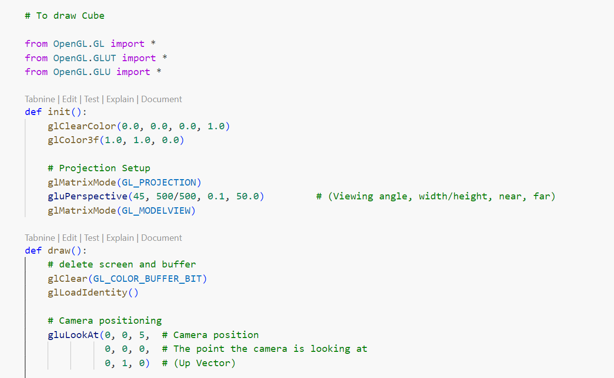

Slide 7
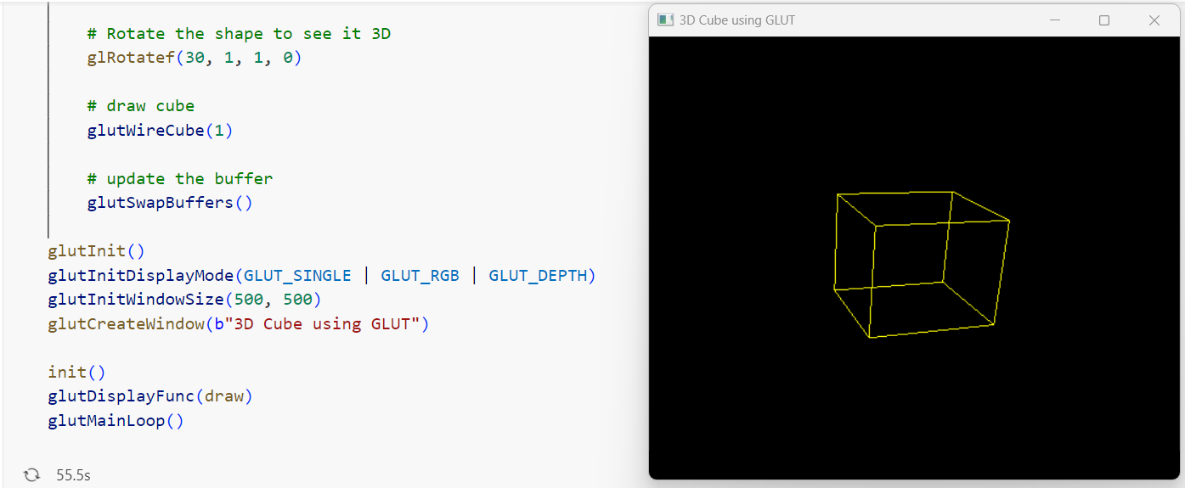


Slide 8

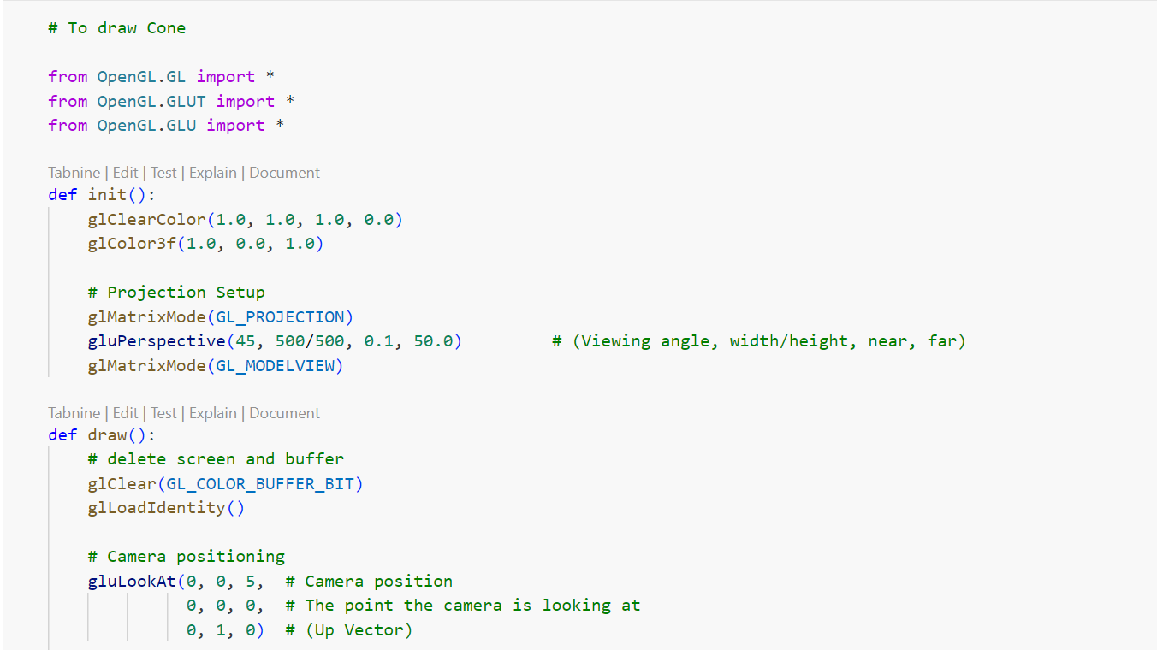

Slide 9
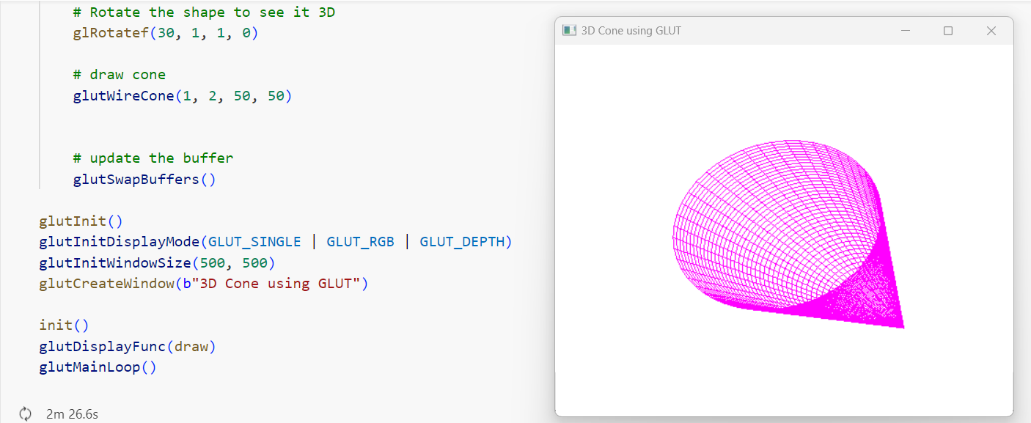

Slide 10
Task

Slide 11
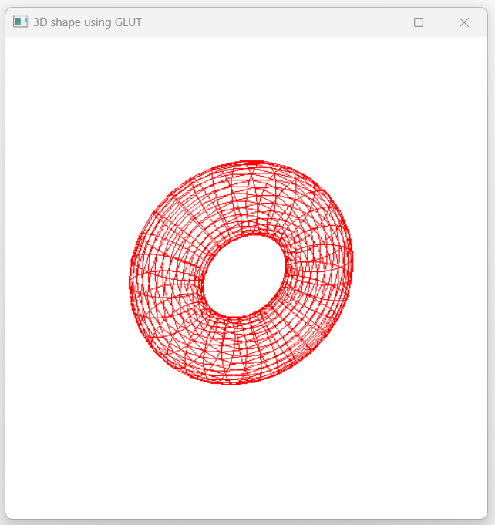
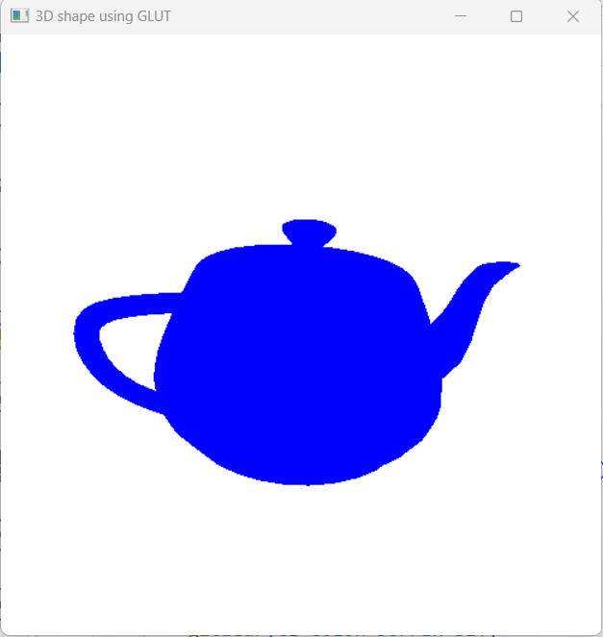

Slide 12
THANK YOU

